Slide 1
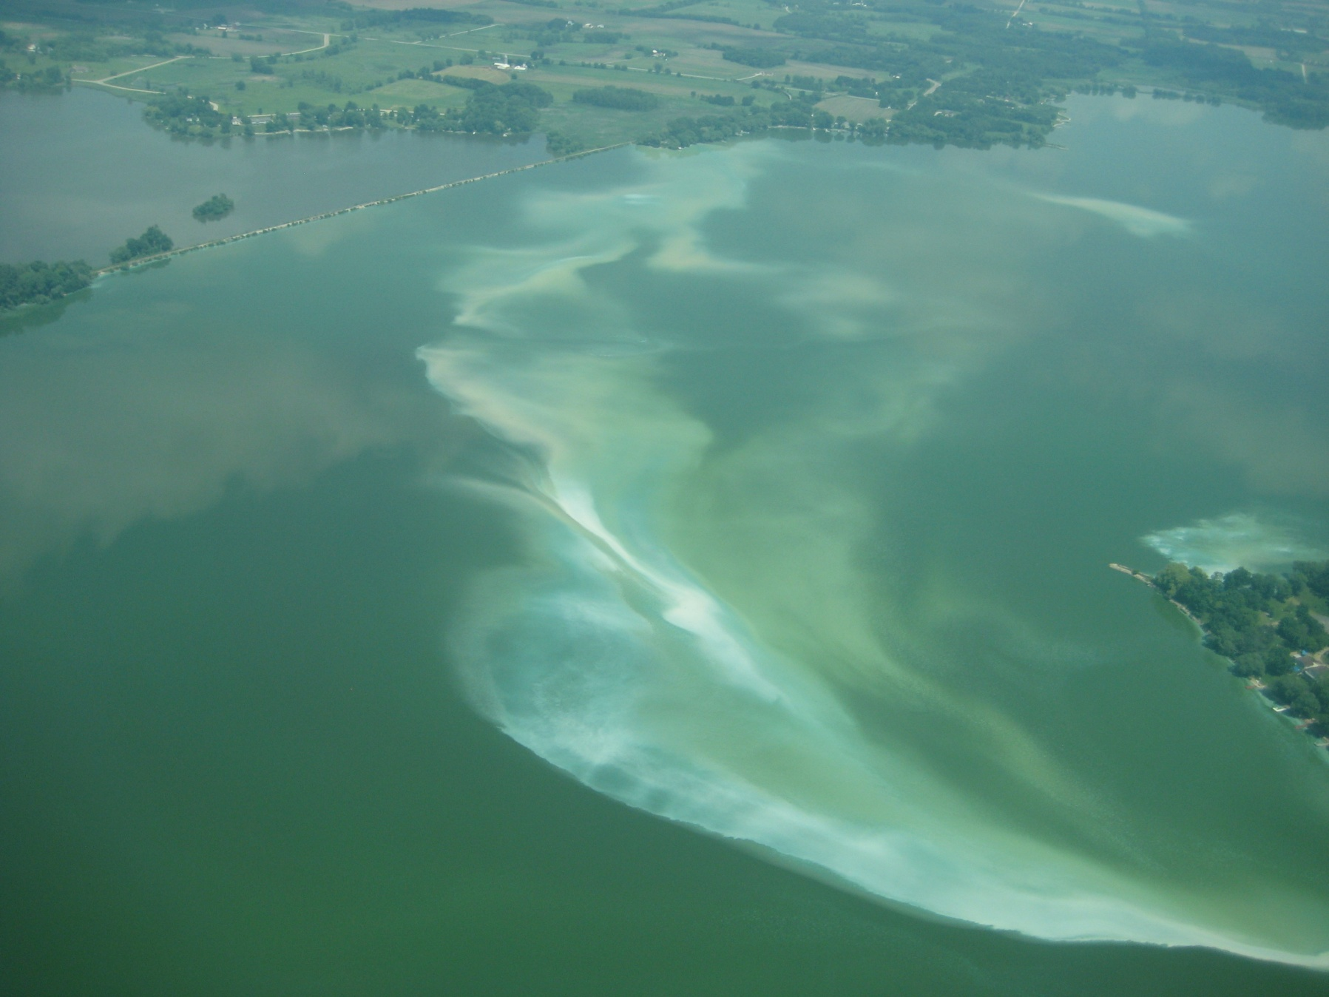
PRAGMA Expedition Lake eutrophication
Paul Hanson, Cayelan Carey,
Renato Figueiredo, Craig Snortheim, Luke Winslow

Slide 2
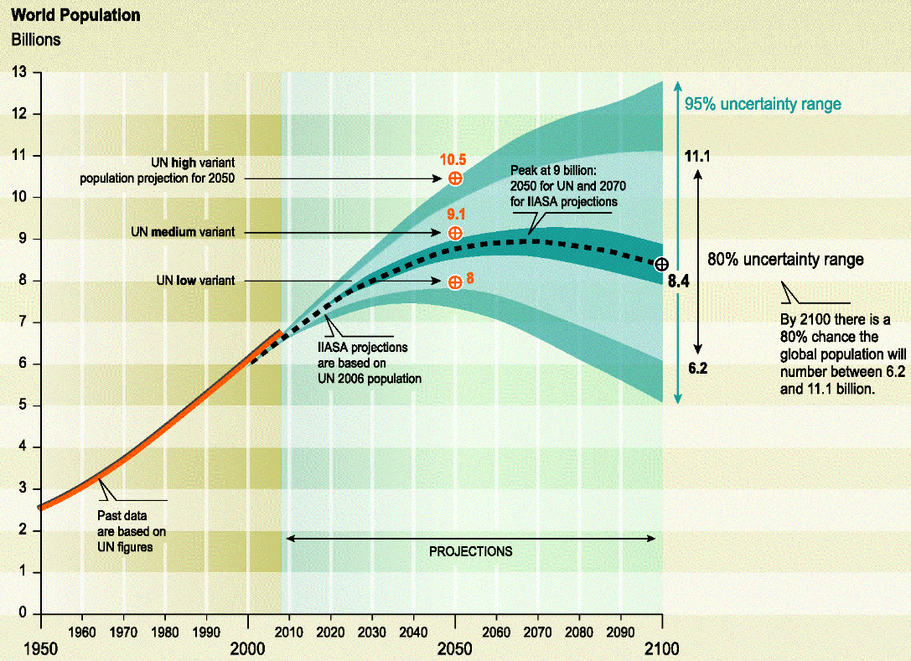

To support the growing global population, agricultural production must increase 70%

Slide 3
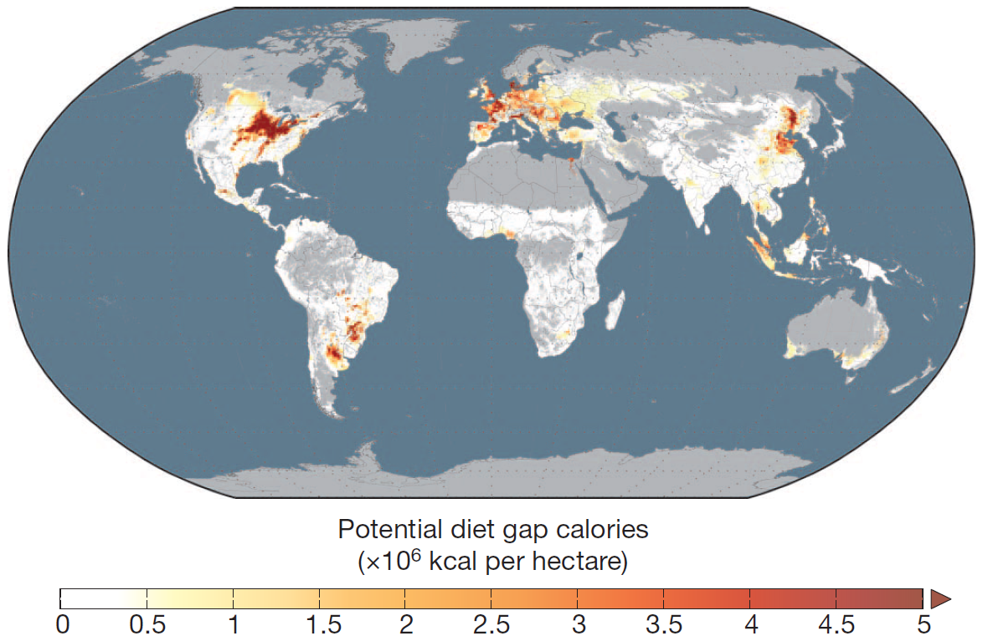
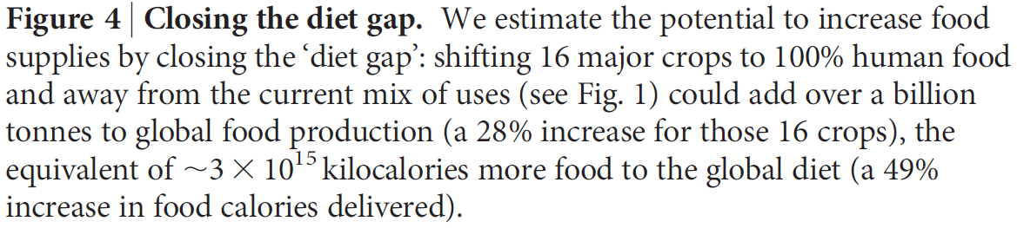
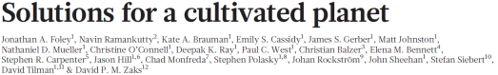

There are only a few places remaining to be converted to 100% food production.

Slide 4
Higher food production requires more water and more nutrients.
An unintended consequence is eutrophication (excess nutrients that degrade water quality).

Slide 5
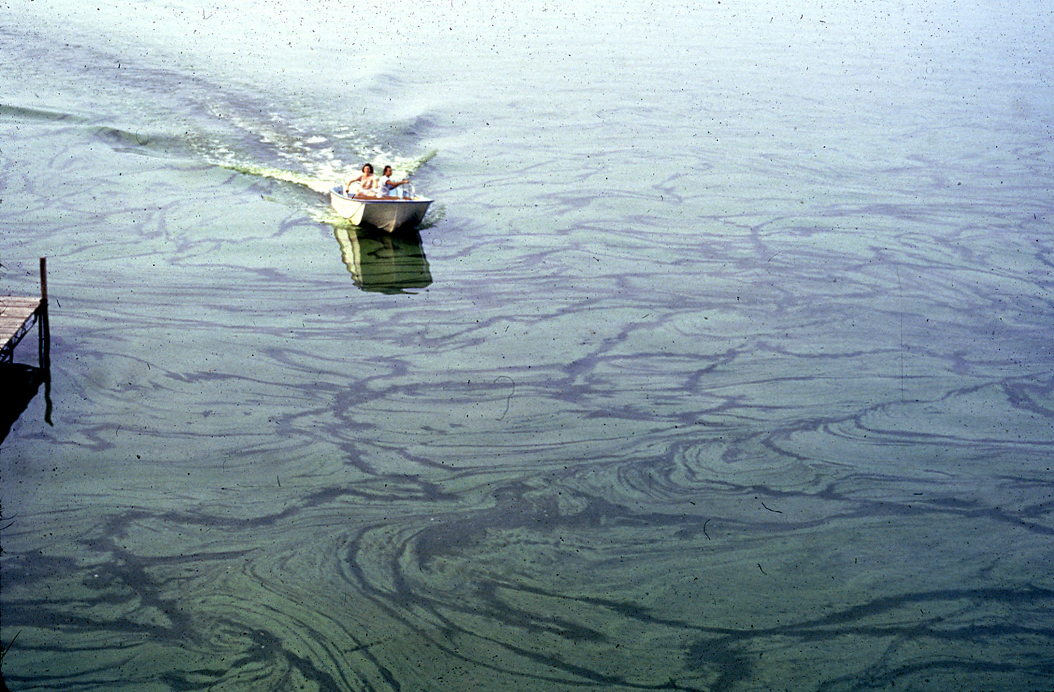
Eutrophication leads to…
Poor water clarity
Loss of macrophytes
Bad smell
Toxic water conditions
Dead fish
Reduced ecological and economic value

Slide 6
Confronting even a narrow slice of this global issue requires:
New data, rapidly becoming available
New models for natural systems
Expertise from multiple disciplines – natural sciences, computer science & technology

Slide 7
Expedition:
Discover the rules controlling phytoplankton community dynamics and water quality

Slide 8
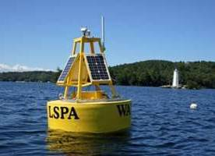
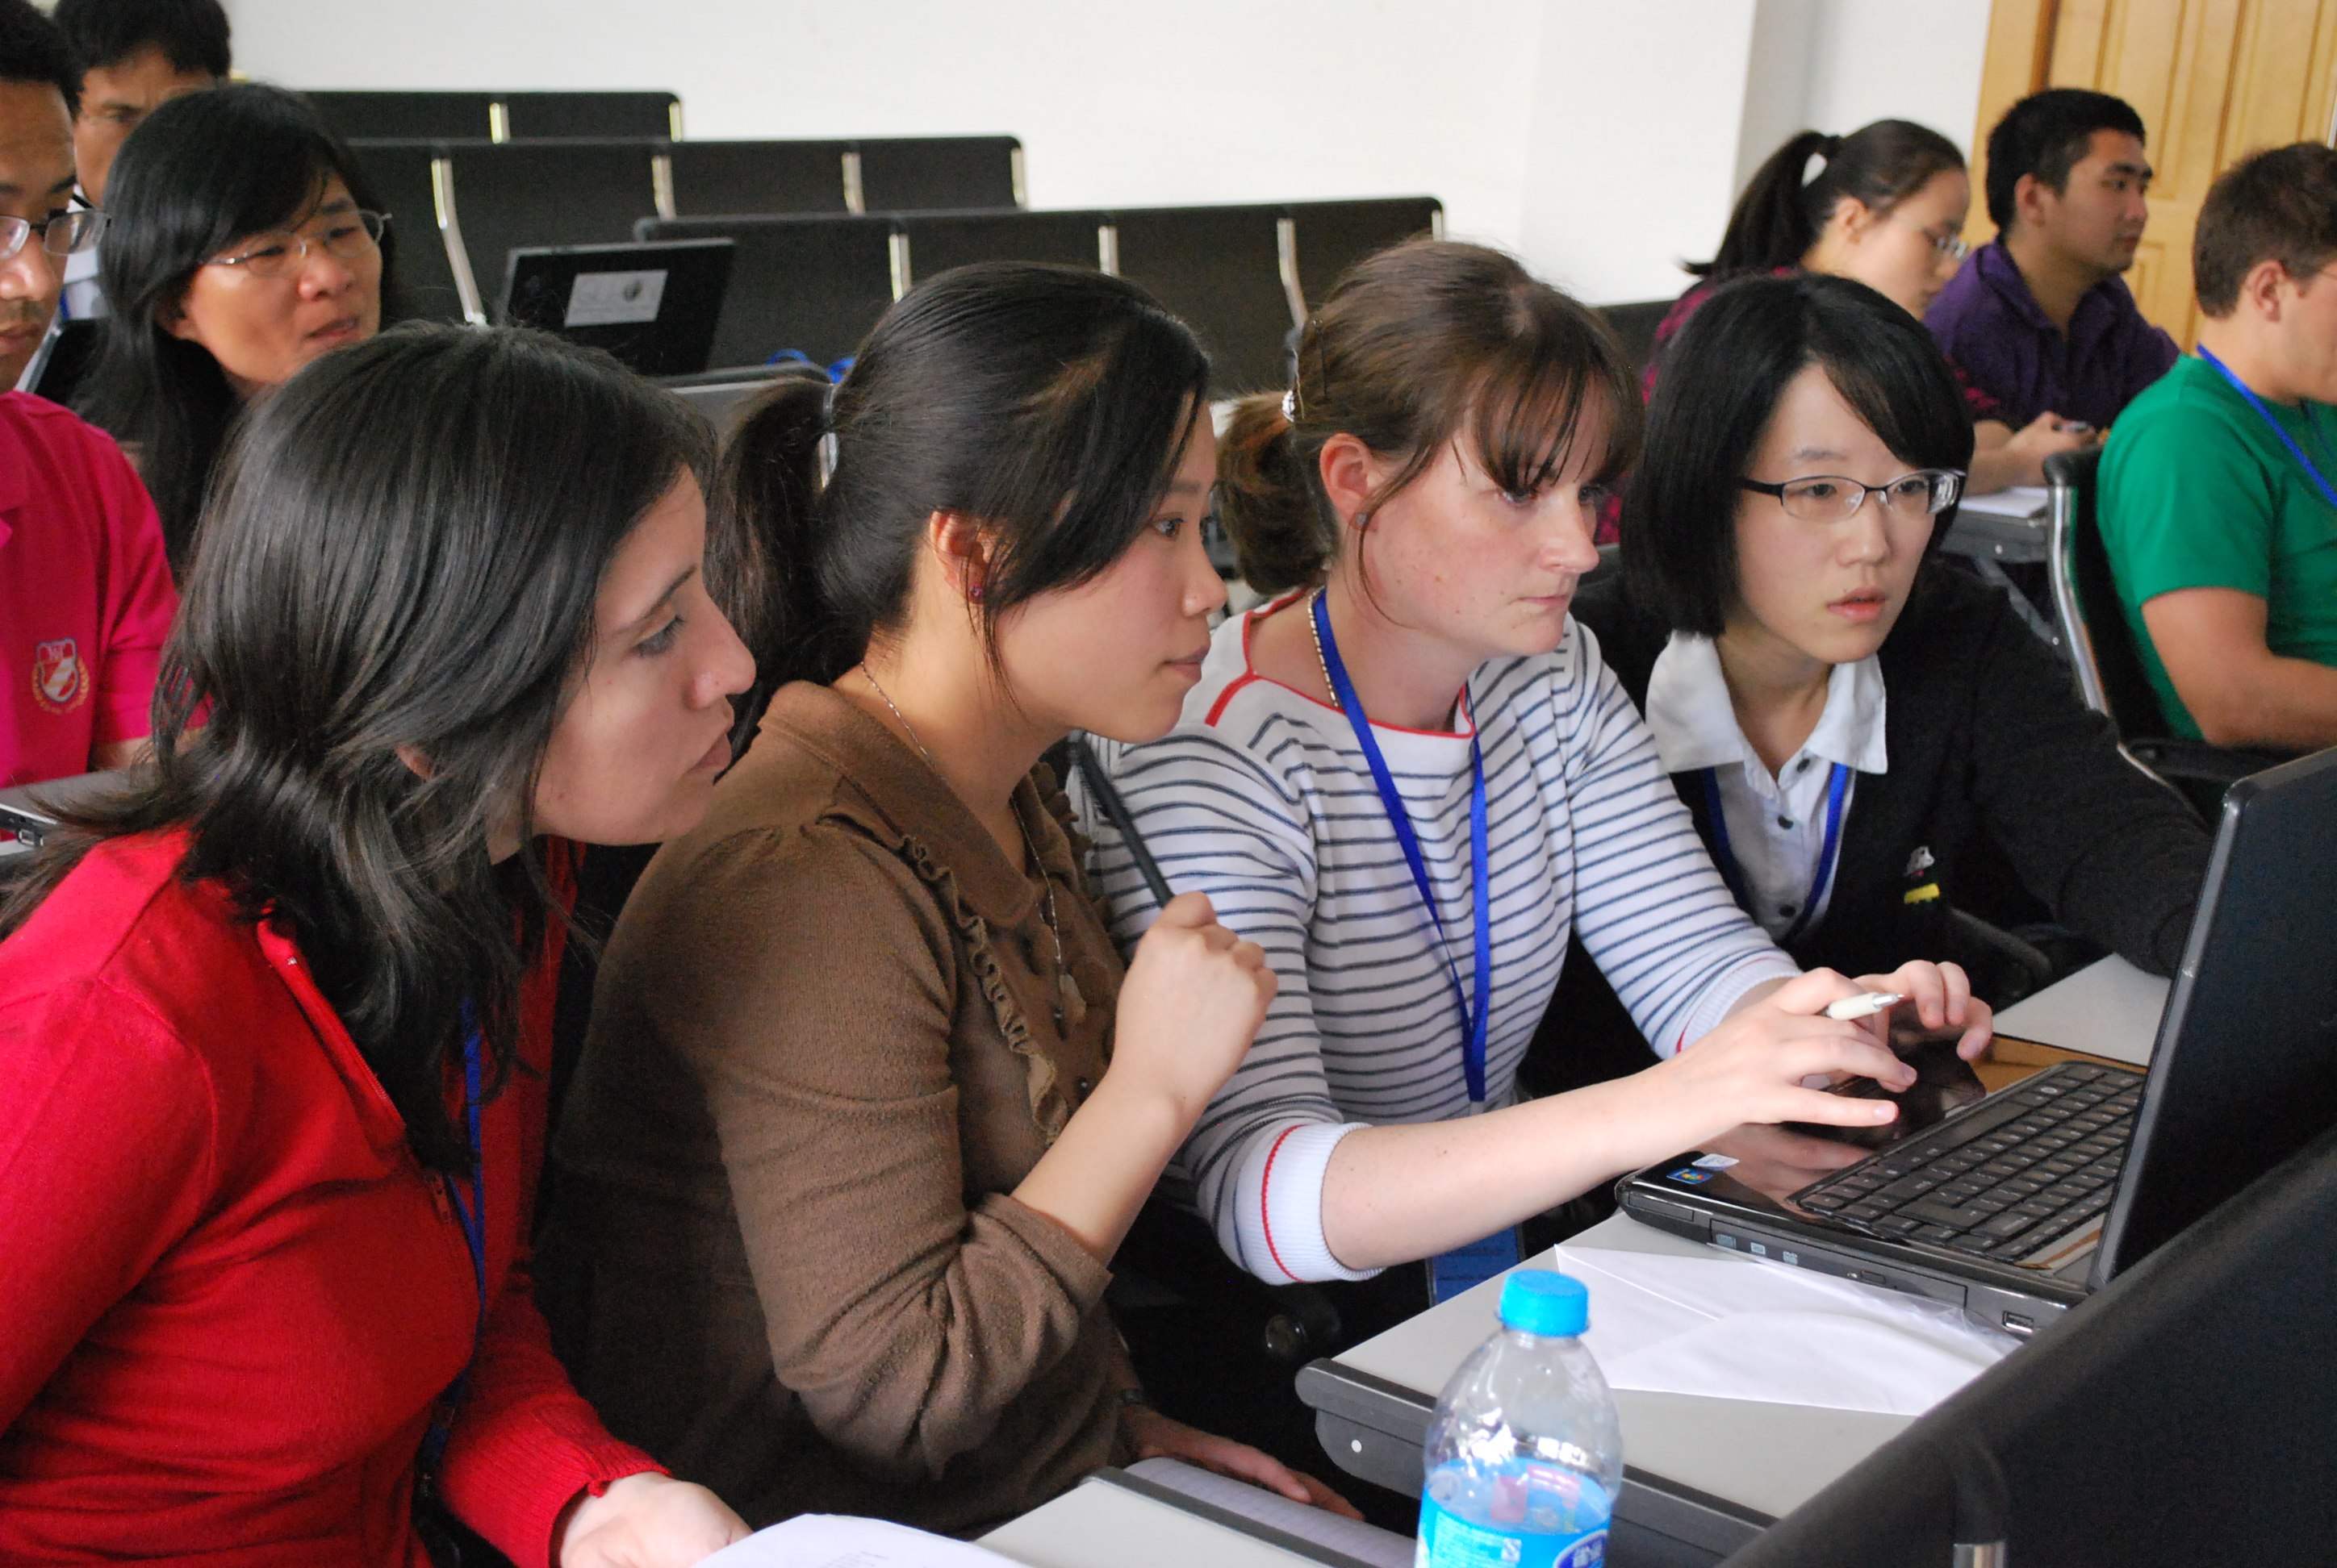
Goals
Create a collaborative human and technological infrastructure that supports distributed team
Obtain new data from GLEON to confront models
Calibrate a new hydrodynamic-water quality model, GLM-FABM-AED, to Lake Mendota, Wisconsin (USA).
Investigate whether the model can reproduce the observed lake physical-biological features of interest
Consider a different set of rules that govern biological communities in lakes
Expand research to additional lakes and broader research community

Slide 9
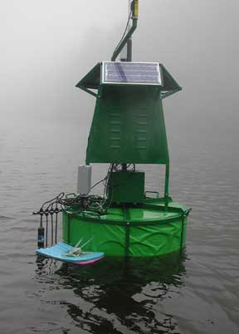
Accomplishments
Data for L. Mendota have been obtained
Lake model has been partially calibrated
Default parameters transferred from literature
Physics calibrated
Water quality calibration begun
HTCondor implementation
“R” code wrapper written for the model
Works for physics, now need the water quality
Overlay network (Florida, Virginia Tech. Wisconsin) installed and in use
Expansion to other sites, Australia and New Zealand, has commenced
Simulations for science
Just beginning!!

Slide 10
Exciting outcomes are being realized:
Demonstration of harmonized distributed resources – people, data, technologies
Working phytoplankton emergence model
Management of thousands of scenarios
Visualizations of complex predictions and observations
Students trained in the science and cyber-infrastructure
Engaged GLEON++ community
Contributions to water quality and eutrophication knowledge (papers!)

